Slide 1

Indian Institute of Technology , Patna
Topic : Convolution Neural Network
Presented By :
Rutuj Waghare (2111MC10)
M.Tech – Mathematics and Computing
Guided By :
Dr. Prashant Srivastava
Associate Professor
Department of Mathematics
[1]

Slide 2
</ Recap >
[2]

Slide 3
Multilayer Neural Network
Predicted result
O21
^
y
O22
output
hidden2
y
hidden1
input
^
Y = W*x + b
Actual result
[3]

Slide 4
Loss function
The loss function is the function that computes the distance between the current output of the algorithm and the expected output. It’s a method to evaluate how your algorithm models the data.
These are the commonly used loss functions to train a Neural Network
Cross-entropy
Log loss
Exponential Loss
Mean Square Error etc.
[4]

Slide 5
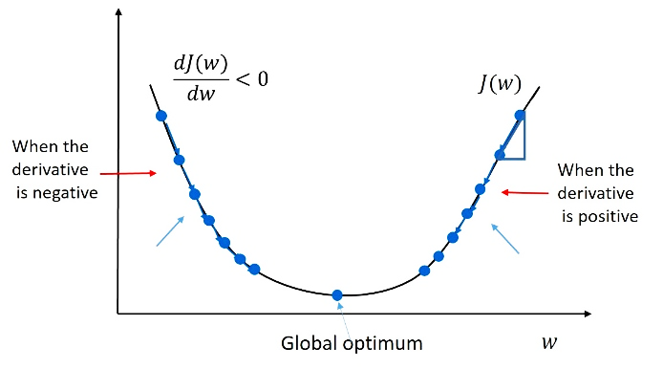
Gradient Descent
[5]
source : https://datahacker.rs/gradient-descent/

Slide 6
Backpropagation
^
O21
y
O22
[6]

Slide 7
Updating Weights and Bias
W(new) = W(old) - learning rate *
(derivative of Loss function with respect to weights)
bias(new) = bias(old) - learning rate *
(derivative of Loss function with respect to bias)
[7]

Slide 8
Learning rate
Learning rate is a hyper-parameter that controls how much we are adjusting the weights of our network with respect the loss gradient.
The lower the value, the slower we travel along the downward slope.
While this might be a good idea (using a low learning rate) in terms of making sure that we do not miss any local minima, it could also mean that we’ll be taking a long time to converge.
[8]

Slide 9
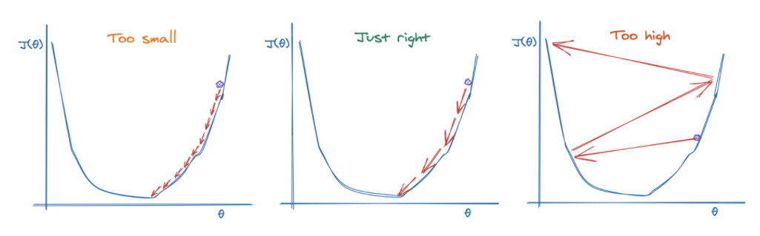
Learning rate
[9]
source : https://morioh.com/p/c13af4aa3fd3

Slide 10
References
[1] https://towardsdatascience.com/understanding-learning-rates-and-how-it-improves-performance-in-deep-learning-d0d4059c1c10 [Accessed on 16 January]
[2]https://www.youtube.com/watch?v=cxPAvoIbsIk&list=PLZoTAELRMXVPGU70ZGsckrMdr0FteeRUi&index=8&ab_channel=KrishNaik [Accessed on 16 January]
[3] https://morioh.com/p/c13af4aa3fd3 [Accessed on 17 January]
[4] https://datahacker.rs/gradient-descent/ [Accessed on 17 January]
[5] https://towardsdatascience.com/what-is-loss-function-1e2605aeb904 [Accessed on 17 January]
[10]

Slide 11
Thank You.
[11]

